Slide 1
LYRICS SEARCH APPLICATION
Group-25
Margi Hingrajia - 201801014
Tejaswa Alia - 201801054
Rahul Khatri - 201801055
TA: Ami Pandat

Slide 2
TIMELINE
REQUIREMENT ANALYSIS
DEVELOPMENT V1.0
SEP-OCT
OCT
OCT-NOV
NOV-DEC
DESIGNING
DEVELOPMENT V2.0

Slide 3
PROJECT BACKGROUND

Slide 4
BACKGROUND
Lyrics Search Application helps people find the lyrics for any song that they want to listen.
It helps to not just find the right lyrics but also help them to personalize it using many different features available.

Slide 5
SCOPE
Our platform aims at helping listeners find the lyrics to their music.
We aim at helping everyone stay updated with the latest trends related to music.
The product will help people filter songs based on factors like explicit lyrics, date of release which would save people’s time while deciding songs to add in playlist.
We aim at providing a product which is very simple to use so that we get a very wide user base across all the age groups and nationalities.

Slide 6
USER INTERFACE

Slide 7
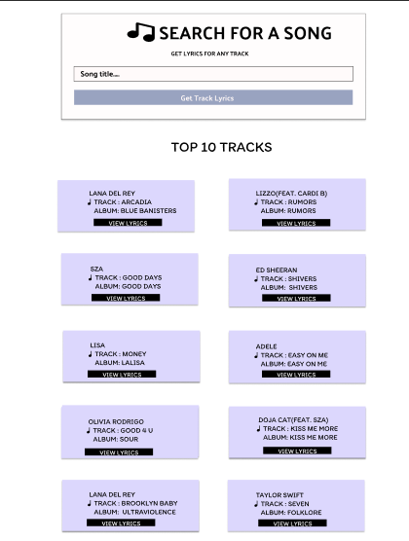

Slide 8
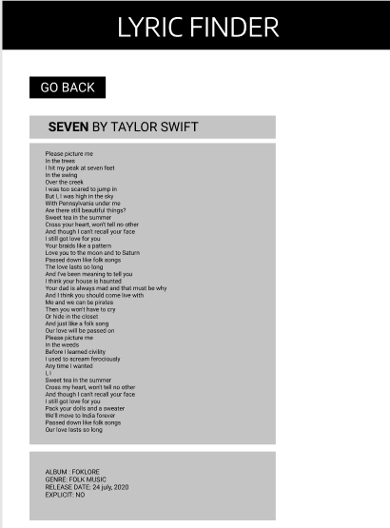

Slide 9
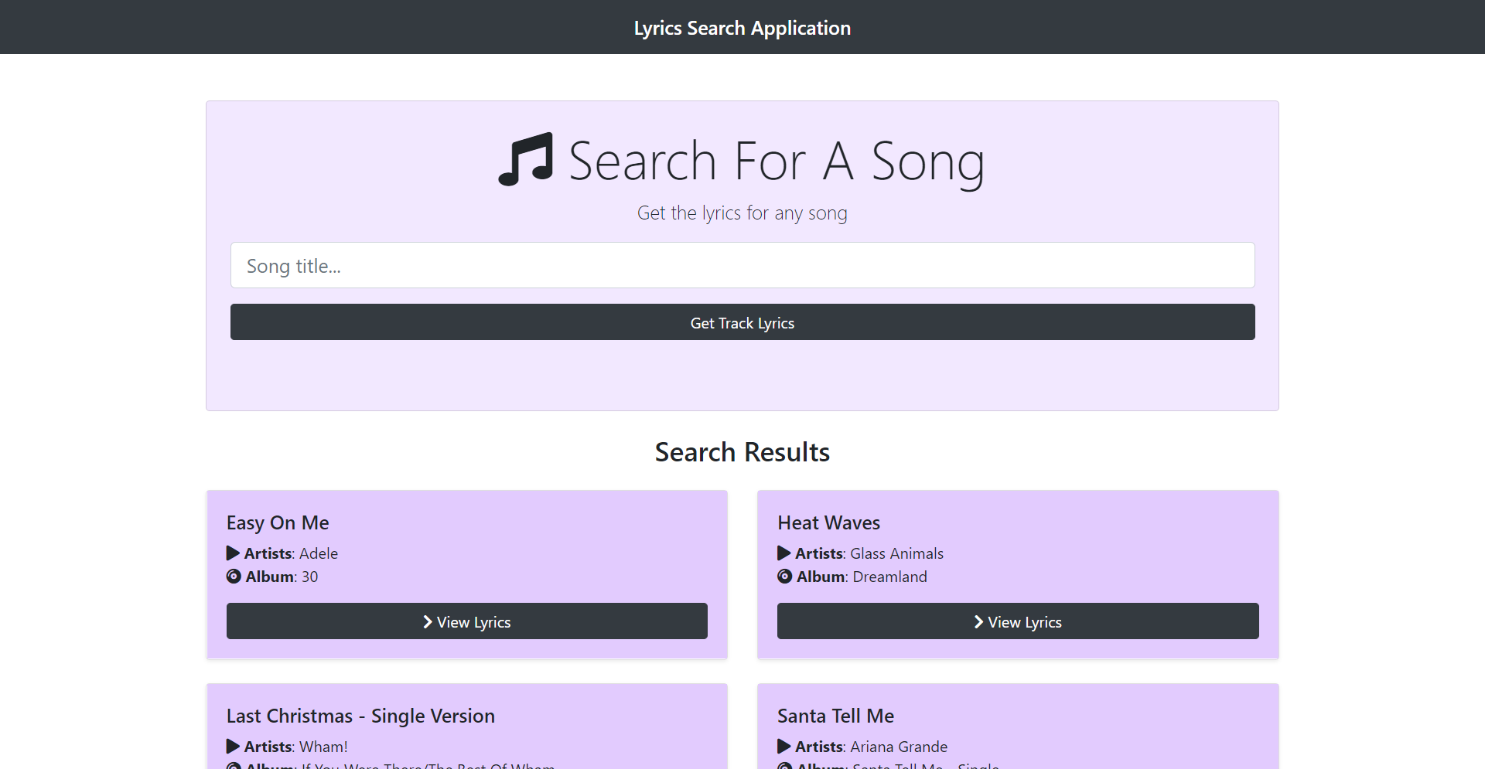

Slide 10
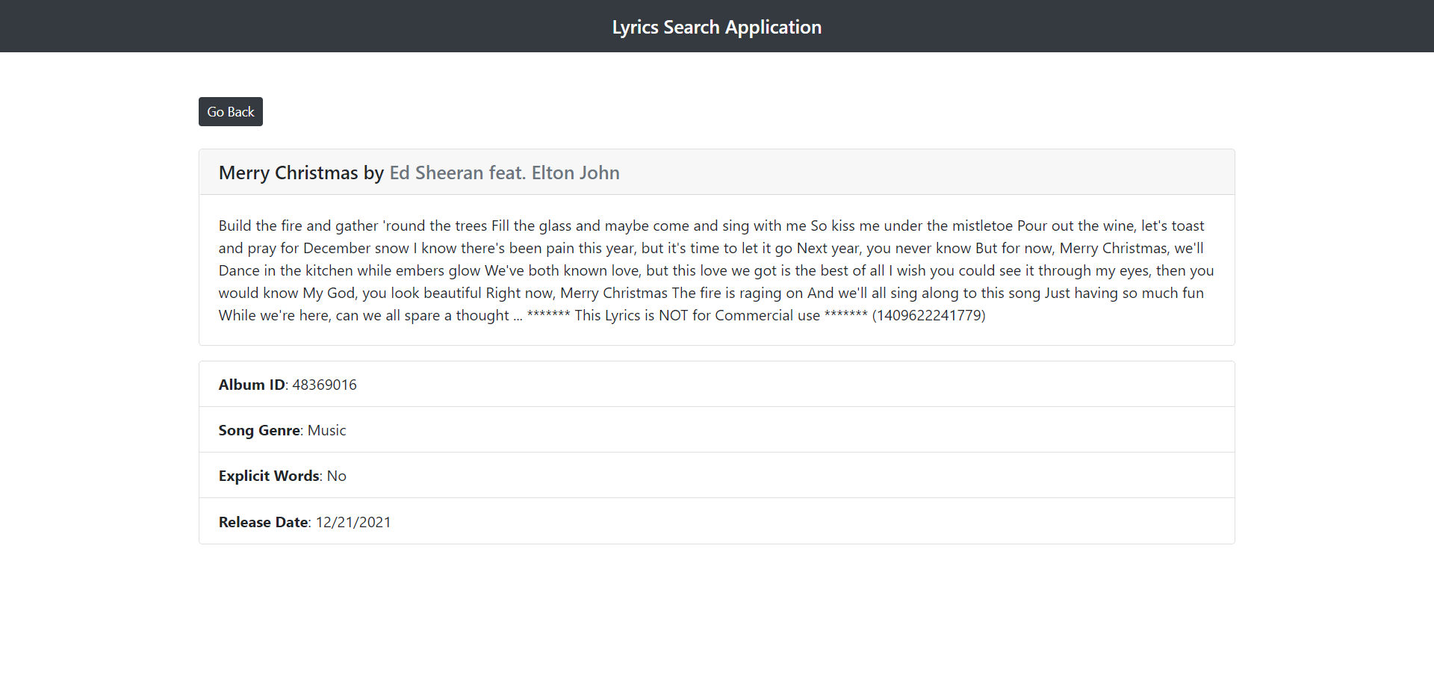

Slide 11
PROJECT OBJECTIVES

Slide 12
BUSINESS RULES
The lyrics should not have copyright issues.
There shouldn’t be any licensing issues while handling any song’s lyrics.
Time taken by the application should be minimal and it should be scalable in the paid version.
Credits due must be given to the writers of the songs.

Slide 13
DESIGN & IMPLEMENTATION CONSTRAINTS
Provide a safe secure login option along with usual email and password (via third party applications like Google account sign in).
The Musixmatch API is paid and hence the version we currently use is free/demo version.
Store the data for personalized playlist of songs and favorites.

Slide 14
SYSTEM DESIGN DIAGRAMS

Slide 15
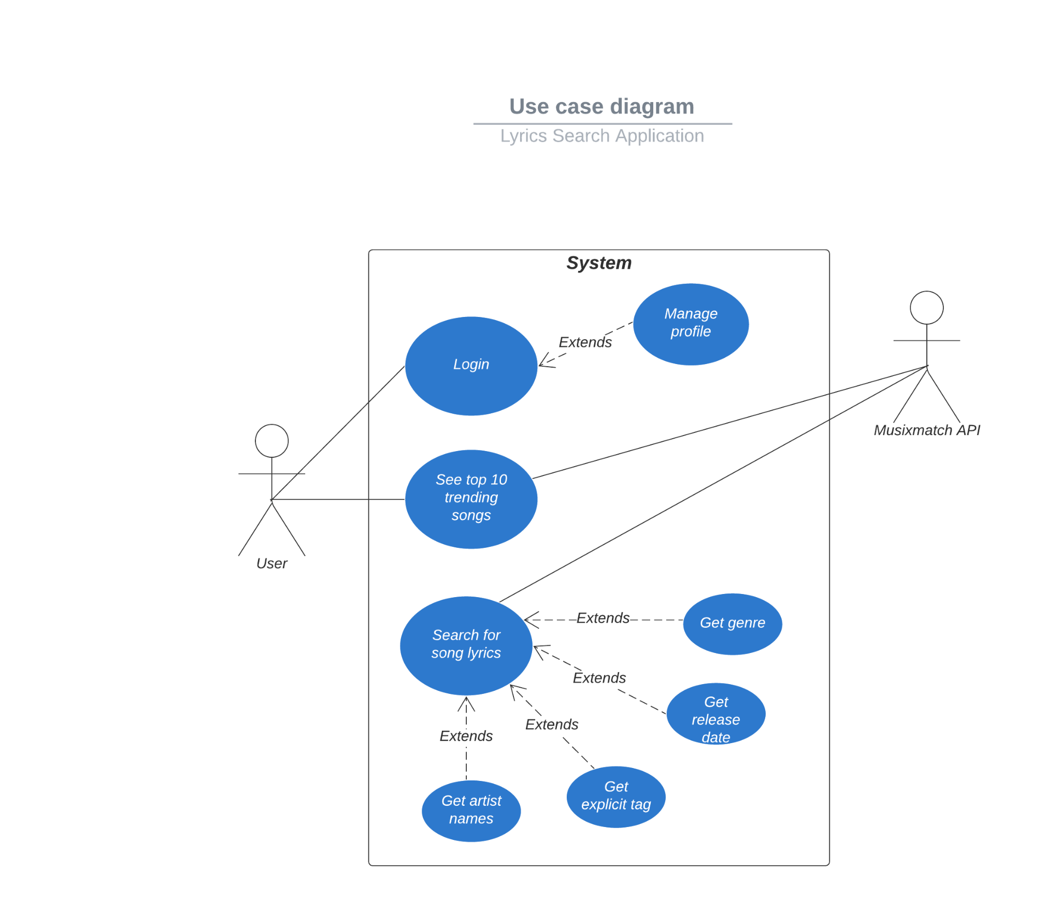
USE CASE DIAGRAM

Slide 16
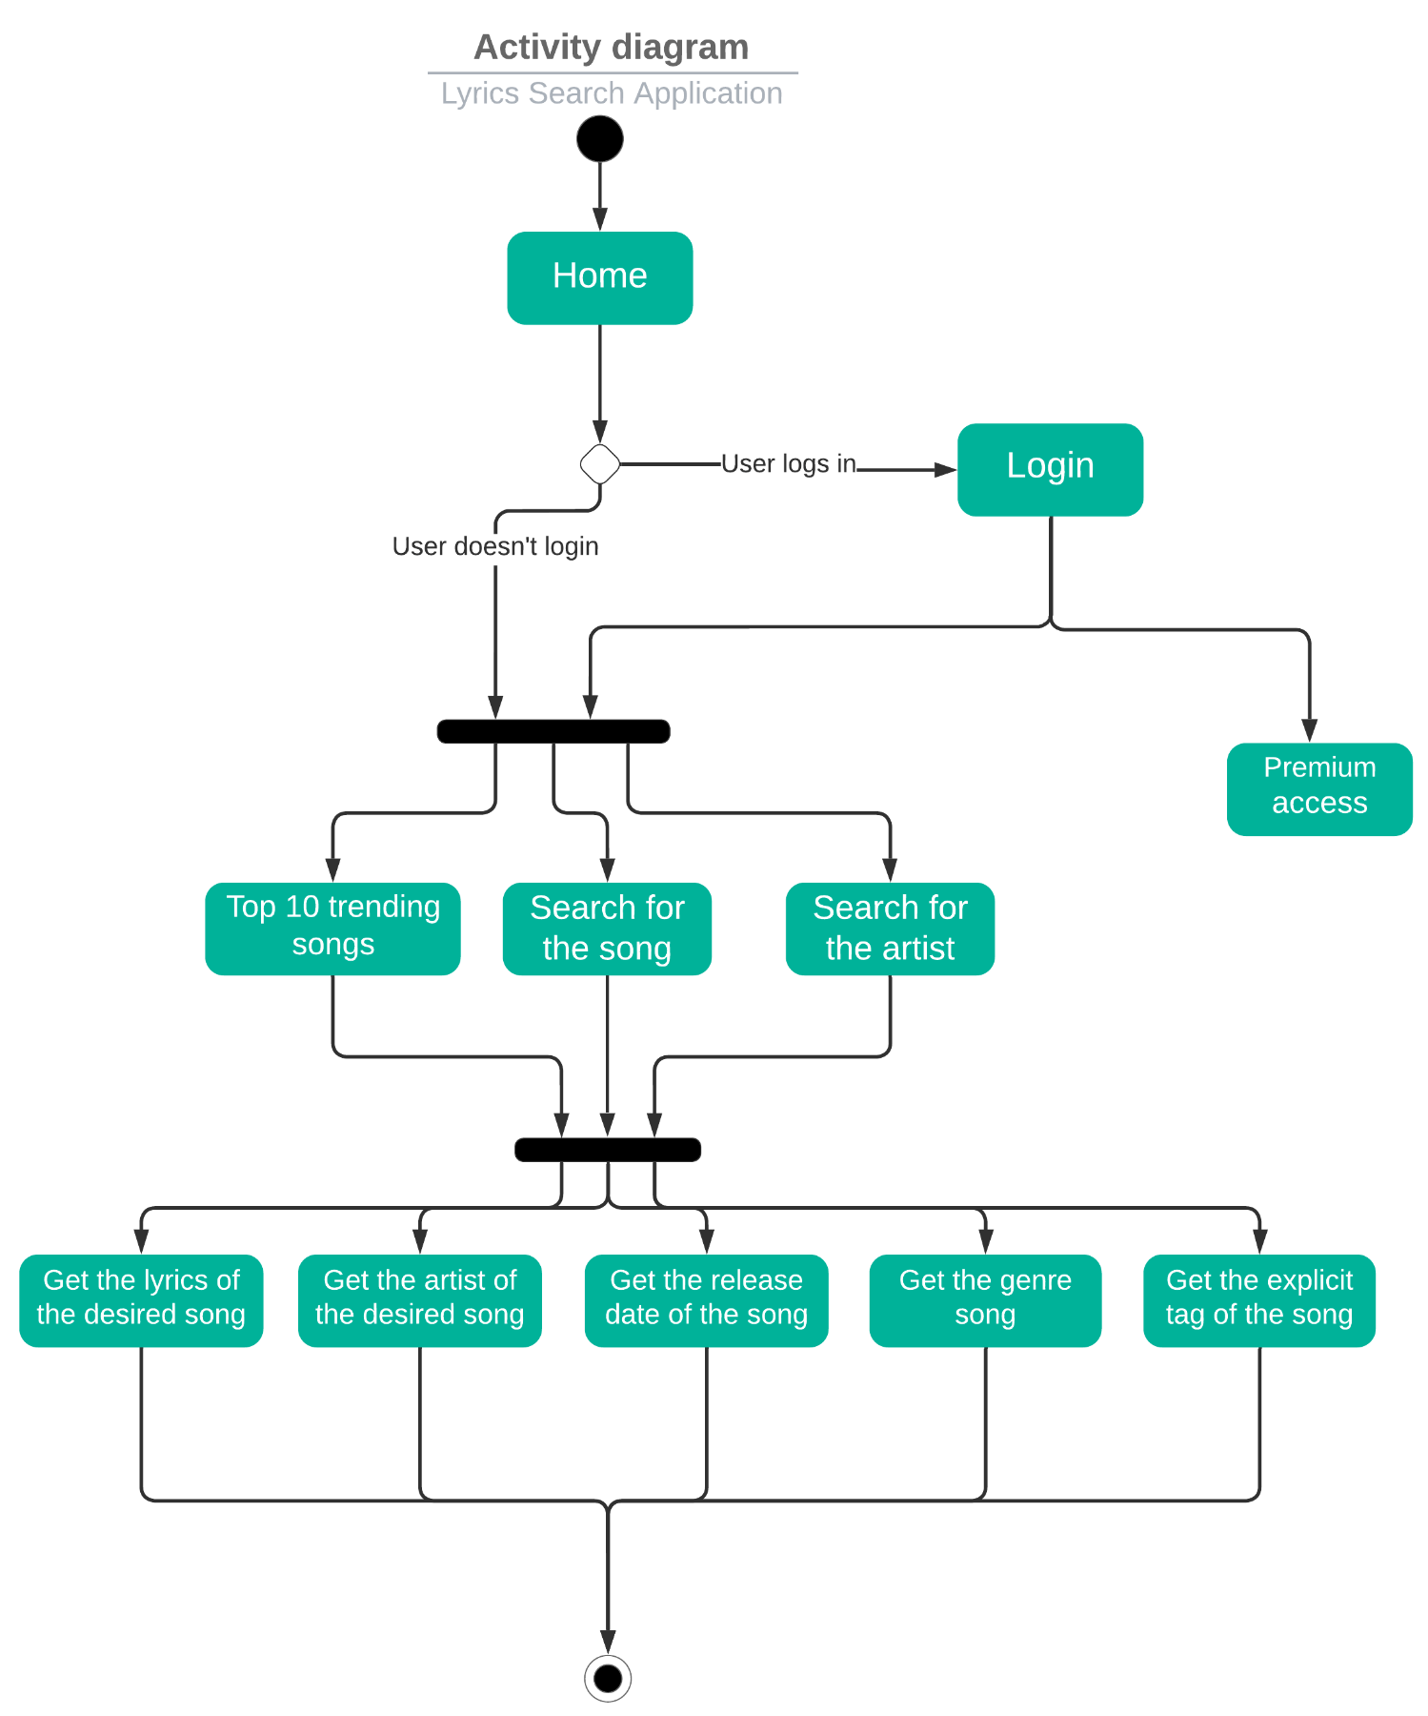
ACTIVITY DIAGRAM

Slide 17
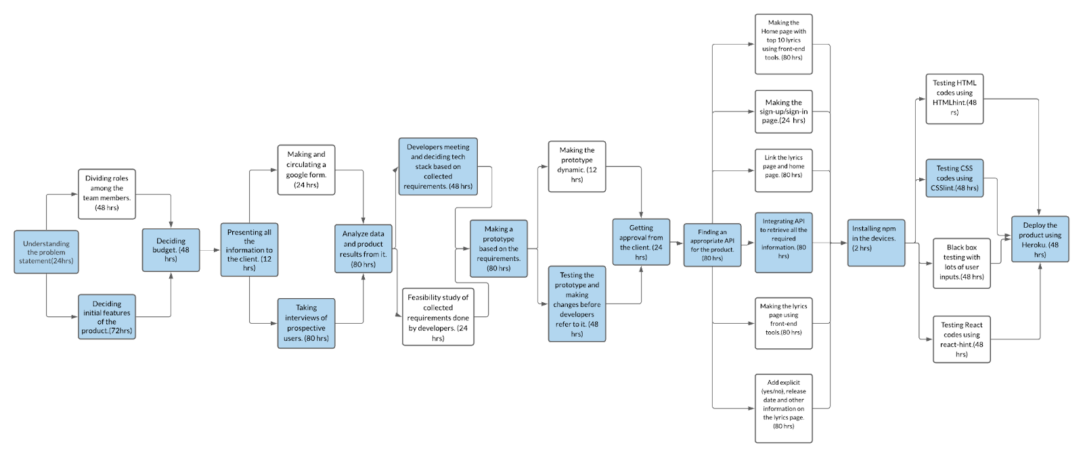
CRITICAL PATH
~35 days

Slide 18
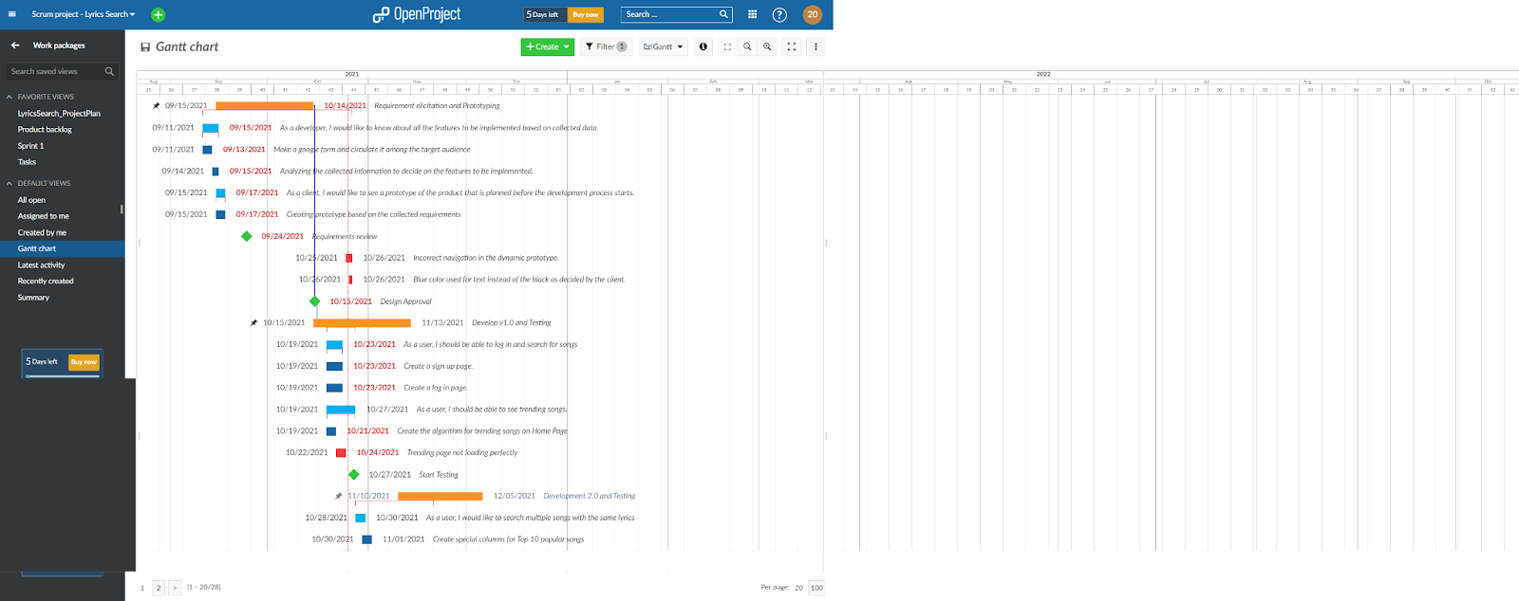
PROJECT PLAN

Slide 19
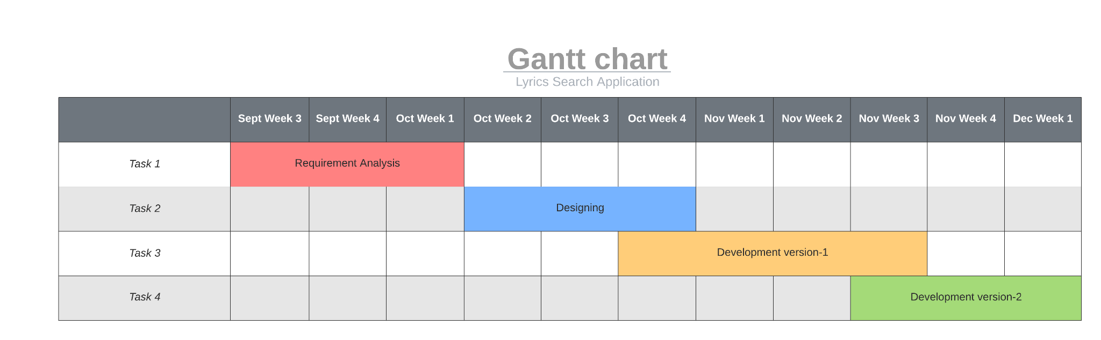
PROJECT PLAN

Slide 20
SYSTEM ARCHITECTURE MODEL

Slide 21
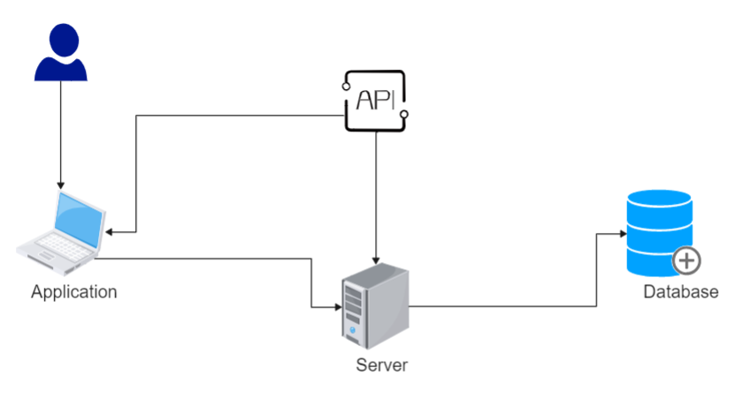

Slide 22
RISKS AND MITIGATION

Slide 23
RISKS
Online security breach: Hackers may have access to sensitive information of an user like their ID/password if proper security measures are not taken
Breach of intellectual property: If IP and other information related to the software/institute is not protected, then one must face dire consequences.
API will stop responding as we have only 100 calls available on a weekly basis.It can cause severe losses to the company.

Slide 24
IMPLEMENTATION TECHNOLOGIES

Slide 25
FRONTEND AND BACKEND
Context API: The React Context API is a way for a React app to effectively produce global variables that can be passed around.
Bootstrap: It is an HTML, CSS and JavaScript framework used for simplification of informative web pages and maintains consistency across tools.
FontAwesome: It is a front-end framework based on CSS which provides a toolkit for fonts and icons for the application.
React.js: The most important tool in this project is a library written in JavaScript and used front-end development to build good user interfaces for the users.
HTML and JavaScript are the two languages used for the development of this application.
Musixmatch API: We used the API of a popular lyrics database system and it is a robust service that permits you to search and retrieve lyrics in a simple manner.

Slide 26
FUTURE WORK

Slide 27
FUTURE WORK/OPEN ISSUES
Improvements on the lyrics displayed in terms of fonts and web page design. Bootstrap can be used much more extensively to decorate the user interface and give the feel of an authentic website.
The home page can contain much more content, considering the Musixmatch API provides a variety of functionality that can be implemented, if necessary.
There can be a feature to store user preferences and recommend related songs on the basis of this history of preferences.
A new feature can be added that directs the user to a website such as Spotify, Amazon Music, YouTube Music or gaana.com where they can listen to the song that they searched for.

Slide 28
CONTRIBUTIONS
Margi Hingrajia: Front-end development, design and implementation constraints, system design and UML diagrams, back-end parts, documentation.
Tejaswa Alia: UI/UX designing, Risk analysis and mitigation, CSS styling, documentation.
Rahul Khatri: API management and finding, back-end part, future works, documentation work.

Slide 29
THANKS!
Any questions?

